Slide 1

INFOSYS SUMMER OF IDEAS
TEAM IC 22: MET-A-FOUR
EXPERIO AR
GUIDED BY INFOSYS MENTORS :
Mr. MAYURESH JAYANT MHAISKAR
Mr. SAMEER SHASHIKANT KULKARNI
TEAM LEADER:
ROMIL NISAR
TEAM MEMBERS:
GANGOTHRI KM
SUBHAJIT LAHA
ADARSH SRIVASTAVA
JANKI CHANDIWALA
Notes:
Janki

Slide 2
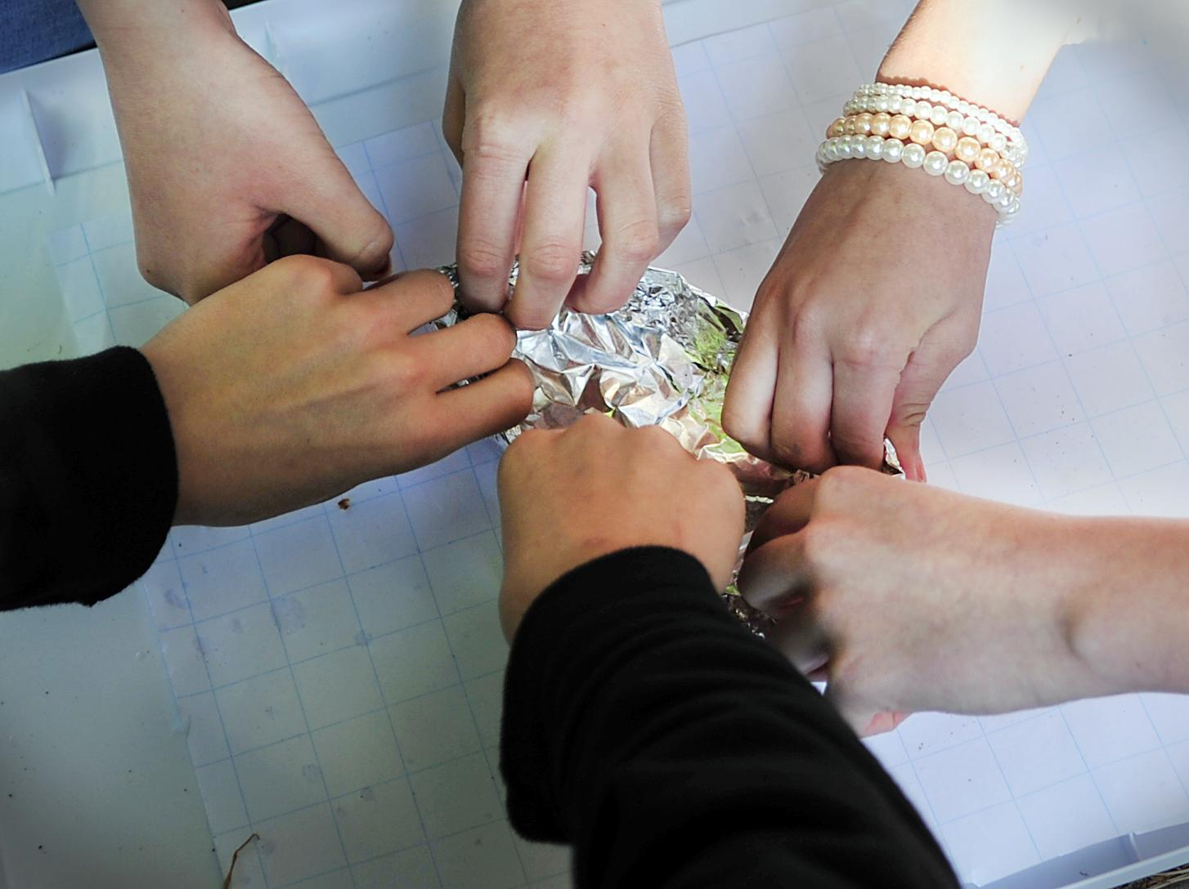
Problem Statement
In the current pandemic situation college students are missing out on industrial based hands on experience. In terms of industry experience they are not at par. For this situation a mobile application that can bring students close to industry expert would help them train better for the future.
A platform they could interact on topics specific to industry such as design patterns or software development methodologies so that they could gain the practical knowledge of what they are taught in class.
Live webinars could be hosted on the platform and discussion forum could be setup on a particular topic.
Premium user can get is AR/VR personalized visiting card. By such visiting card any user who has this card can know all detail about the user like his past experience, his projects and stuffs. This might be similar to showcasing your resume using an ar/vr enabled card.

Slide 3
Desirability

Slide 4


Problems
Understanding course expectations.
Lack of in-person interaction
Adapting to unfamiliar technology
Uncertainty about the future
Difficulty differentiating between what skills are actually necessary for the industry
Challenges
Un-ability of students to actually connect to experts and interact.
A sense of isolation without correct guidance
A more independent way of learning
The ease of procrastinating
HR spending a lot of time reading long resumes

Slide 5
EXPERIO AR- OUR SOLUTION
Towards our best efforts to resolves all the problems and challenges that both students and HRs face during this time of scarcity of resources, we propose an application- ‘Experio AR’, application that connects students to experts and industry working professionals.
An interactive platform to engage new generation in the trends in companies by providing feeds of industry experts.
It is also incorporated with AR in order to provide an ease of retrieve one’s resume.
The feature to be able to create rooms with members/experts interested in that field/ discussion and have live session with them to connect.

Slide 6

VALUE ADDED FOR STAKEHOLDERS
Stakeholders:
Students
Educational Institutes
Working Professionals, Subject Experts
Augmented Reality and scope to Virtual Reality
Apt with the Current Situation
An alternative required to regular Cover letter and Time taking Introduction methods?
AR Business Card Resume
Reduces the hiring party’s time by giving them all the information at one sight.
Edgy technologies to the fingertips for student well as for each stakeholders involved

Slide 7
Feasibility

Slide 8








TECHNOLOGY STACK
HTTP

Slide 9

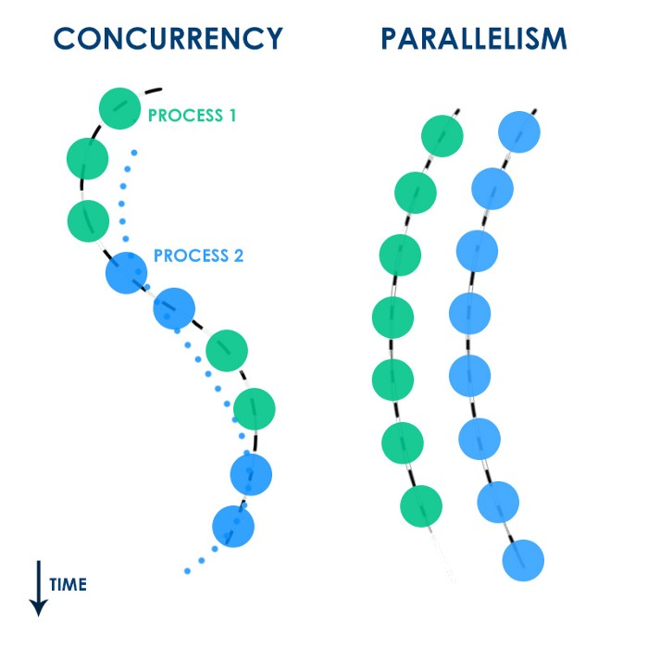
Ease of Access
8 item/pages in Side MENU section
Binary based search
Sorting of related Users
Graphic Balanced Content
Concurrency
Asynchronous handling of request-response cycle.
Java supports different threads for multiple computation at same time and so does the Android Studio
Each request processed more quickly
Cross platform usage of technology among XML, SQL, Vuforia

Slide 10
Security Feature
Password encrypted using Tactics with Firebase
Generate a separate authenticated token for each and every user and only available for the signed in device
Session maintenance with SHA-256 encryption
Time Access
Embedded documents directly into the FireBase which are unchangeable & it reduces the query complexity into O(logN).
Uses compressed and Optimised content on feed
Additionally compacting a Database updates in Data Statistics, which can be used by a query to run faster.

Slide 11
System Requirements
While Building (DESKTOP)
8GB RAM
Android Studio >v12
Firebase connectivity
Vuforia Library
Unity
While Usage (SmartPhone)
>3.0 Android Version
>2GB RAM
> 5MP Camera
>100 MB Free Storage

Slide 12
Infosys current capabilities and gaps
Infosys is one of the biggest multinational corporation that provides various services.
Companies are looking to harness the capability of AR/VR to achieve this.
Infosys does work on AR/VR experience to augment and amplify the human experience with over 60 years of combined experience in enterprise AR solutions simulators, large scale VR experiences, etc.
Thus we don’t find any gaps regarding our project and otherwise. Also we feel that us implementing ar/vr in our application makes it more worthwhile.

Slide 13
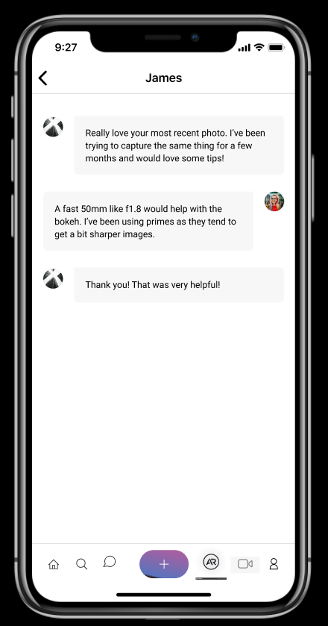
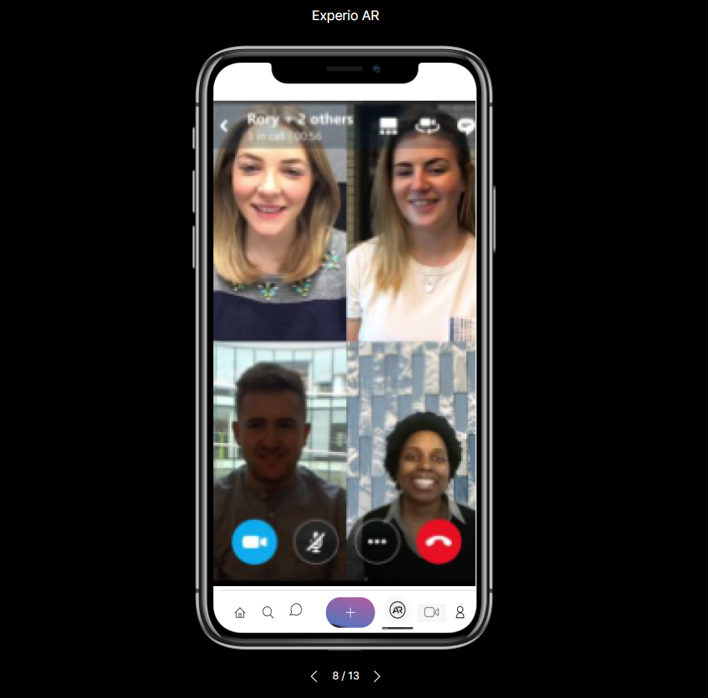
App Modules
1. Video Chat Rooms
Nothing can match the Face2Face interaction and with the current situation, these chatrooms gives you a similar environment.

Slide 14
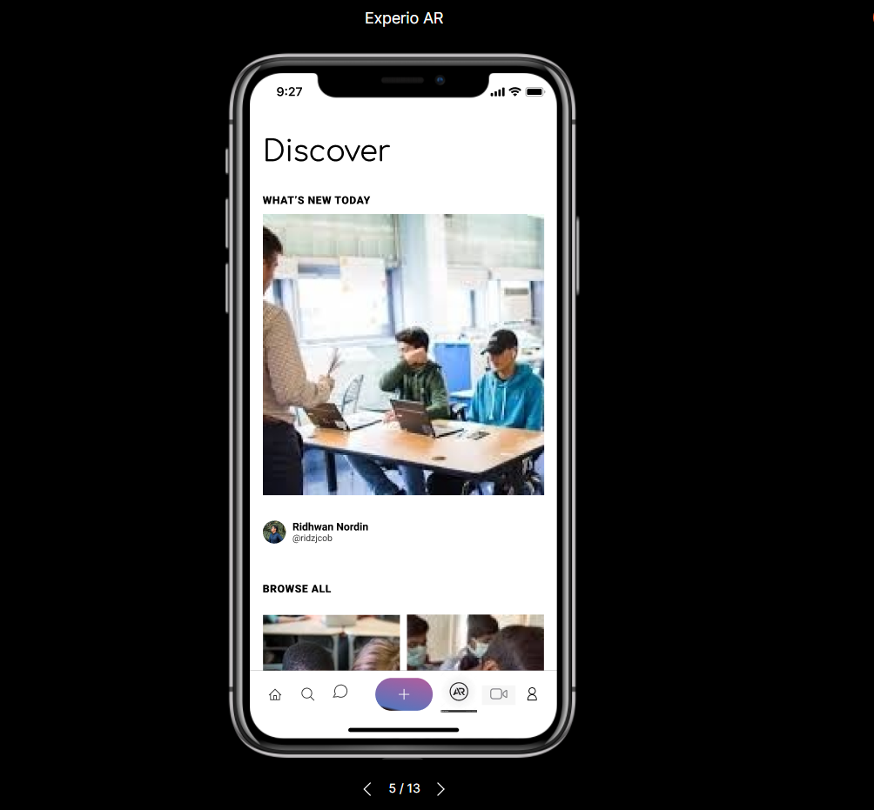
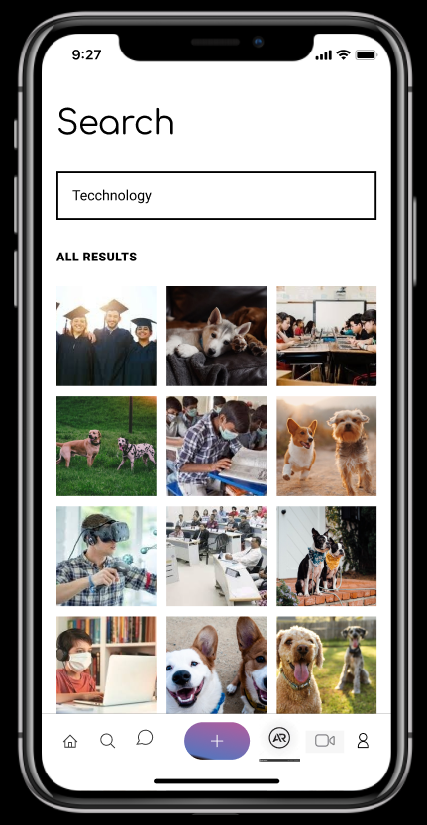
2.Discovery Module
Opening the world to your fingertips, 'Discovery' offers you to explore contributions in different fields by renowned people and gives u the platform to share yours too.
3.AR Resume Module
The ultimate amalgam between present reality and virtual environment offers the Upright Introduction through QR Code.

Slide 15

VIDEO OF THE AR PERCEPTION

Slide 16
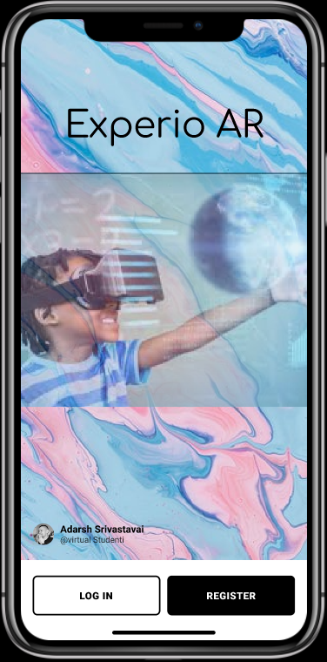
Flow of modules in Prototype
Place your screenshot here

Slide 17
Viability

Slide 18
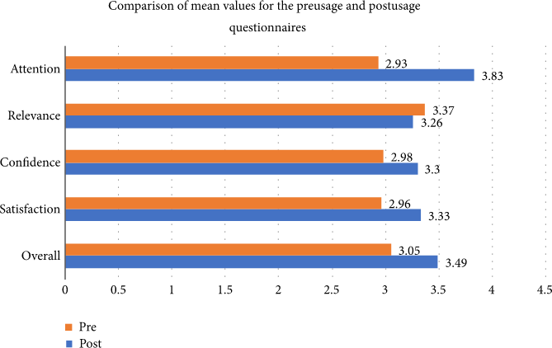
The given graph shows us that how people benefit over the use of AR in different domains.

Slide 19
VIABILITY CHARACTERISTICS
Best of best candidate.
User friendly.
Eco-friendly.
Saves time and energy.
Better communication
One on one interaction

Slide 20
FUTURE SCOPE
There can be a few modifications that can help this app become more unique and user friendly like:
Feature add-ons.
Audio virtual assistant / Chatbot.
Face detection unlock system.

Slide 21
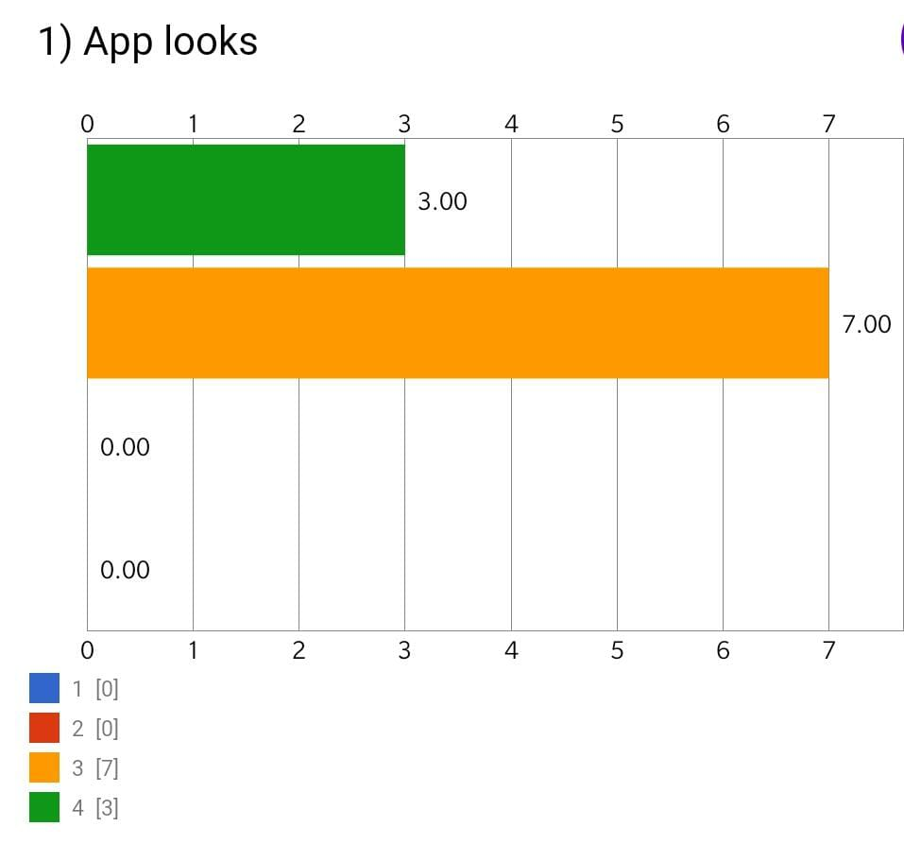
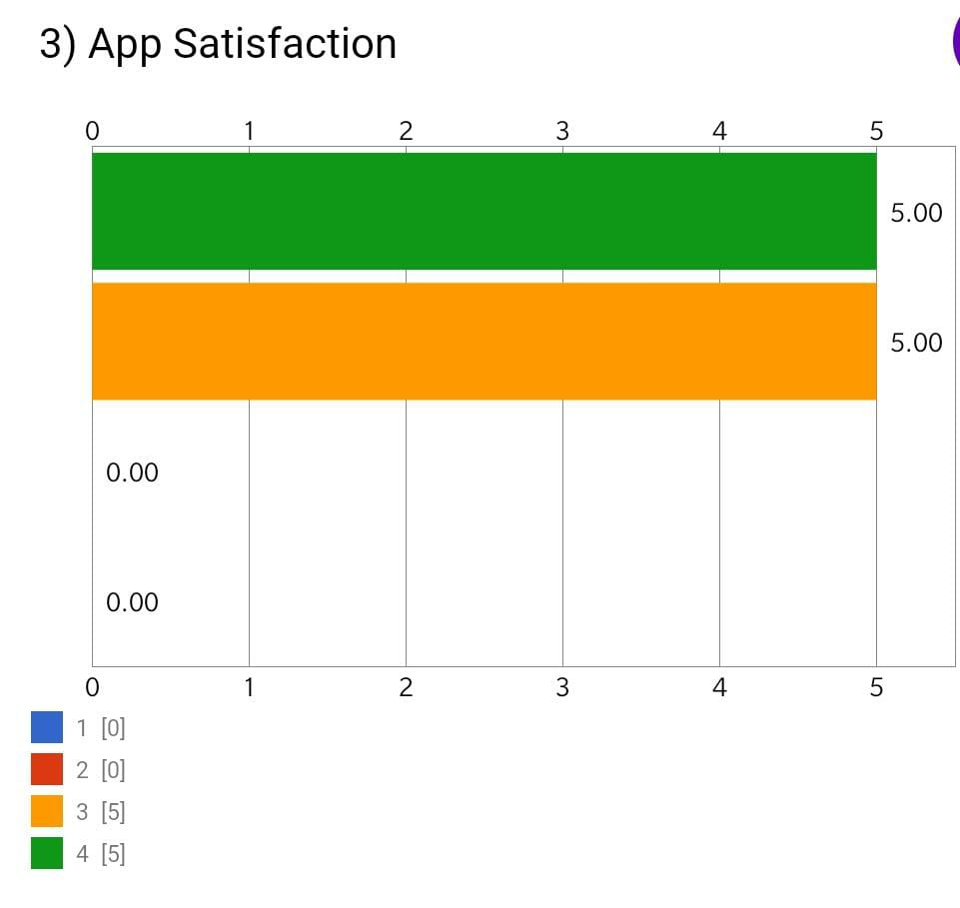
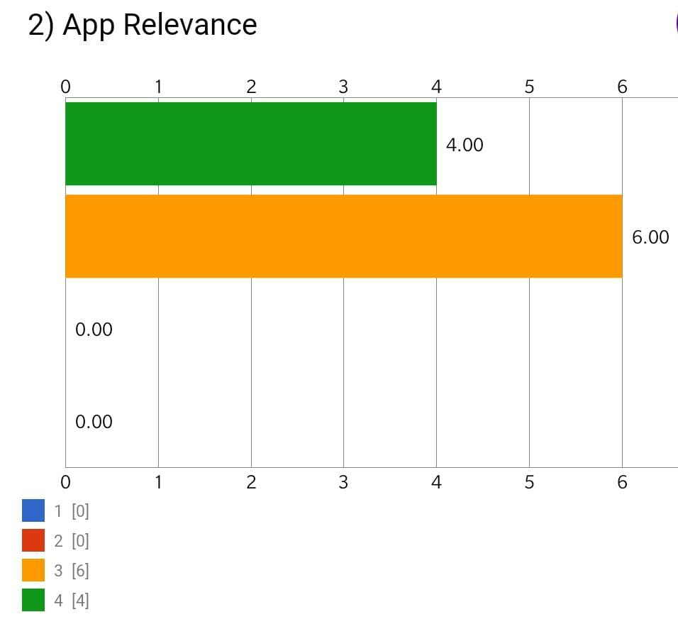
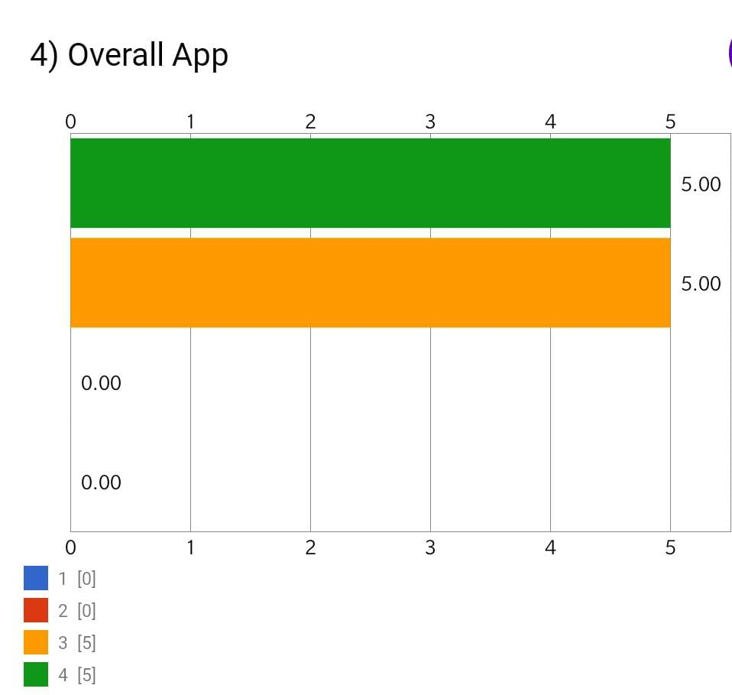
F
E
E
D
B
A
C
K

Slide 22

THANKS!
WE WOULD LIKE TO THANK INFOSYS FOR PROVIDING US WITH THIS OPPORTUNITY

Slide 23
We are open for questions!

